Slide 1
Computer networks and network attacks
Artem Lenskiy
artem.Lenskiy@anu.edu.au

Slide 2
C language
The C programming language was designed by Dennis Ritchie as a systems programming language for Unix.
The GNU Project (GNU is not Unix) is a free software, mass collaboration project, announced on 27 September 1983, by Richard Stallman at MIT.
An optimized C compiler (GCC) is part of this project.

Slide 3
Minimal C program
beginning
// The simplest program in C
int main(){ // entrance point to a C program
// program's functionality is here
return 0; // main function needs to return an integer
}
end
The name main is special, because it is the first function called.
Other functions are called directly or indirectly from main.
The line return 0; is used to tell the operating system (UNIX or Windows) that the program exited normally (Status=0).
A nonzero status indicates an error—the bigger the return value, the more severe the error.

Slide 4
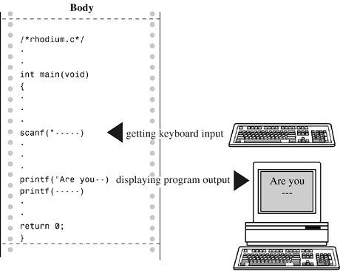
Interactive program
The interactive approach makes programs more flexible;
The scanf() and printf() functions make this interactivity possible.
#include <stdio.h>
int main(){
float weight, height;
printf("Enter your weight(kg) and hight(m): ");
//any entered two numbers will be stored
//in weight and height
scanf("%f %f", &weight, &height);
//calculate body mass index
float bmi = weight / (height * height);
printf("Your body mass index is %f \n", bmi);
return 0;
}
#include <stdio.h>
This statement signals that we are going to use the standard I/O package. The statement is a type of data declaration

Slide 5

printf function
The library function printf can be used to print the results.
The special characters %d are called the integer conversion specification. When printf encounters a %d, it prints the value of the next expression in the list following the format string.
The general form of the printf statement is:
printf(format, expression-1, expression-2, ...);
where format is the string describing what to print.
Twice 15 is 30
int term = 2;
printf("Twice %d is %d\n", term, 2 * term);

Slide 6
scanf function
The library function scanf can be used to read input.
The special characters %d are called the integer conversion specification. When scanf encounters a %d, it converts the entered value to integer.
int term, term_2;
printf("Enter two integers:");
scanf("%d %d", &term, &term_2);
printf("You entered %d and %d \n", term, term_2);
Enter two integers:1 2
You entered 1 and 2

Slide 7
Calculator
#include <stdio.h> // print and read functions
float calculator (char op, float a, float b){
switch (op) {
case '+':
return a + b;
case '-':
return a - b;
default:
printf("Wrong operator");
return 0;
}
int main() {
float a, b;
char op;
printf("Enter an arithmetic expression (e.g. 5 * 4):");
scanf("%f %c %f", &a, &op, &b);
printf("\n%f %c %f = %f\n", a, op, b, calculator(op, a, b));
return 0;
}
Implement a calculator program
Notes:
#include <stdio.h> // print and read functions
float calculator (char op, float a, float b){
switch (op) {
case '+':
return a + b;
case '-':
return a - b;
default:
printf("Wrong operator");
return 0;
}
}
int main() {
float a, b;
char op;
printf("Enter an arithmetic expression (e.g. 5 * 4):");
scanf("%f %c %f", &a, &op, &b);
printf("\n%f %c %f = %f\n", a, op, b, calculator(op, a, b));
return 0;
}

Slide 8
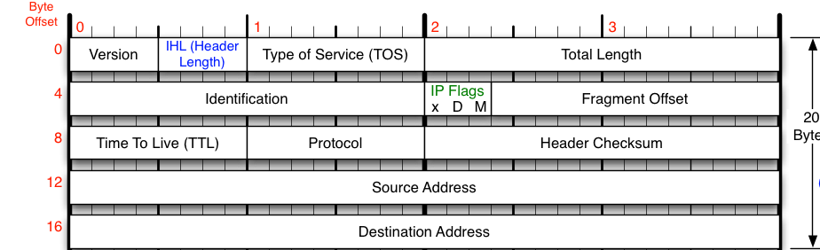
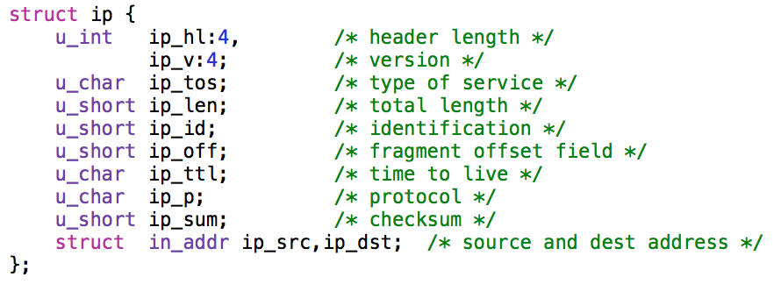
Network layer
IP provide the following services:
Fragmentation, in case the datagram is larger than the maximum transmission unit (MTU)
A time-to-live(TTL) field that prevents looped packets from circling forever
A type-of-service label to provide priority for certain classes of packets
An upper-layer protocol identifier to direct the packet to the correct transport layer.

Slide 9
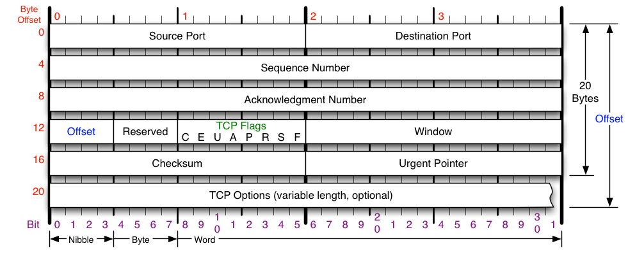
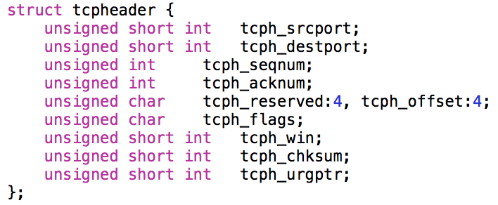
Transport layer
transport protocols run in end systems
sender side: breaks app messages into segments, passes to network layer
receiver side: reassembles segments into messages, passes to app layer
service point addressing
reliable, in-order delivery (TCP)

Slide 10

A network socket
A socket is an entry onto a network.
To transmit data to another computer, you create a socket, tell it how to find the other computer, and then tell it to send.
To receive data, you create a socket, tell it which computer to listen to (in some cases), and then wait for data to come pouring in.
application
socket
application
controlled by
app developer
process
process
transport
transport
network
network
controlled
by OS
link
Internet
link
physical
physical

Slide 11
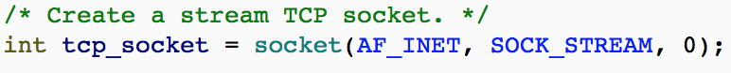
Two sockets types
Transport Control Protocol (TCP) socket
Type: SOCK_STREAM
Reliable delivery
In-order guaranteed
Connection-oriented
Bidirectional
User Datagram Protocol (UDP) socket
Type: SOCK_DGRAM
Unreliable delivery
No order guarantees
No notion of “connection” – app indicates destination for each packet
Can send or receive

Slide 12
Socket Creation in C
int s = socket(domain, type, protocol);
s : socket descriptor, an integer (like a file-handle)
domain : integer, communication domain
e.g., PF_INET (IPv4 protocol) – typically used
type : communication type
SOCK_STREAM: reliable, 2-way, connection-based service
SOCK_DGRAM: unreliable, connectionless,
other values: need root permission, rarely used, or obsolete
protocol : specifies protocol (see file /etc/protocols for a list of options) - usually set to 0

Slide 13
The bind function
The bind function associates and (can exclusively) reserves a port for use by the socket
int status = bind(sockid, &addrport, size);
status : error status, = -1 if bind failed
sockid : integer, socket descriptor
addrport : struct sockaddr, the (IP) address and port of the machine (address usually set to INADDR_ANY – chooses a local address)
size : the size (in bytes) of the addrport structure

Slide 14
Connection Setup
A connection occurs between two ends
Server: waits for an active participant to request connection
Client: initiates connection request to passive side
Once connection is established, server and client ends are “similar”
both can send & receive data
either can terminate the connection

Slide 15
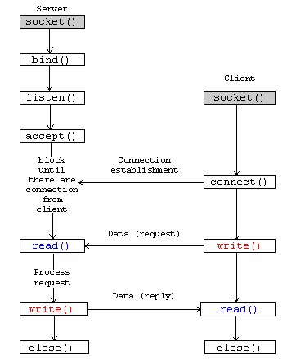
The socket APIs for connection-oriented protocol (TCP)
1. The stream listener socket
3. The "accept" socket.
2. The stream client socket.
send()
recv()

Slide 16
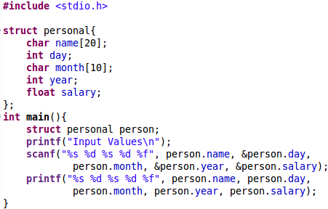
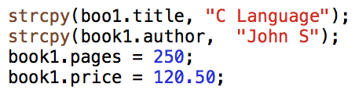
Structures in C
The link between a member and a variable is established using the member operator ‘.’ (also know as ‘dot operator’).
book1.price
Assigning examples

Slide 17
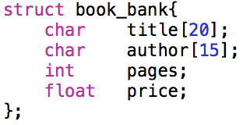
Structures in C: Memory representation
title
array of 20 characters
Memory representation
structure
author
array of 15 characters
array of 20 characters
array of 15 characters
integer
float
pages
integer
price
float
sizeof(book_bank) is 44 bytes

Slide 18
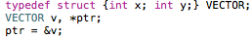
Structures in C: Three ways to access members
We have used the dot operator to access the number of structures variables. There are two other ways:
The identifier ptr is a pointer that has been assigned the address of the structure variable v.
Now, the members can be accessed in three ways:
using dot notation : v.xx
using indirection notation : (*ptr).x
using selection notation : ptr→x

Slide 19
Client
#include <stdio.h>
#include <sys/socket.h>
#include <arpa/inet.h>
#include <unistd.h>
#include <string.h>
#define PORT 8080
int main(int argc, char const *argv[]){
int sock = 0, valread;
struct sockaddr_in serv_addr;
char *hello = "Hello from client";
char buffer[1024] = {0};
if ((sock = socket(AF_INET, SOCK_STREAM, 0)) < 0){
printf("\n Socket creation error \n");
return -1;
}
serv_addr.sin_family = AF_INET;
serv_addr.sin_port = htons(PORT);
// Convert IPv4 and IPv6 addresses from text to binary form
if(inet_pton(AF_INET, "127.0.0.1", &serv_addr.sin_addr) <= 0){ //3.21.167.186
printf("\nInvalid address/ Address not supported \n");
return -1;
}
if (connect(sock, (struct sockaddr *)&serv_addr, sizeof(serv_addr)) < 0){
printf("\nConnection Failed \n");
return -1;
}
send(sock , hello , strlen(hello) , 0 );
printf("Hello message sent\n");
valread = read( sock , buffer, 1024);
printf("%s\n",buffer );
return 0;
}
Notes:
#include <stdio.h>
#include <sys/socket.h>
#include <arpa/inet.h>
#include <unistd.h>
#include <string.h>
#define PORT 8080
int main(int argc, char const *argv[]){
int sock = 0, valread;
struct sockaddr_in serv_addr;
char *hello = "Hello from client";
char buffer[1024] = {0};
if ((sock = socket(AF_INET, SOCK_STREAM, 0)) < 0){
printf("\n Socket creation error \n");
return -1;
}
serv_addr.sin_family = AF_INET;
serv_addr.sin_port = htons(PORT);
// Convert IPv4 and IPv6 addresses from text to binary form
if(inet_pton(AF_INET, "127.0.0.1", &serv_addr.sin_addr) <= 0){ //3.21.167.186
printf("\nInvalid address/ Address not supported \n");
return -1;
}
if (connect(sock, (struct sockaddr *)&serv_addr, sizeof(serv_addr)) < 0){
printf("\nConnection Failed \n");
return -1;
}
send(sock , hello , strlen(hello) , 0 );
printf("Hello message sent\n");
valread = read( sock , buffer, 1024);
printf("%s\n",buffer );
return 0;
}

Slide 20
Server
#include <unistd.h>
#include <stdio.h>
#include <sys/socket.h>
#include <stdlib.h>
#include <netinet/in.h>
#include <string.h>
#define PORT 8080
int main(int argc, char const *argv[])
{
int server_fd, new_socket, valread;
struct sockaddr_in address;
int opt = 1;
int addrlen = sizeof(address);
char buffer[1024] = {0};
char *hello = "Hello from server";
// Creating socket file descriptor
if ((server_fd = socket(AF_INET, SOCK_STREAM, 0)) == 0){
perror("socket failed");
exit(EXIT_FAILURE);
}
...
Notes:
#include <unistd.h>
#include <stdio.h>
#include <sys/socket.h>
#include <stdlib.h>
#include <netinet/in.h>
#include <string.h>
#define PORT 8080
int main(int argc, char const *argv[])
{
int server_fd, new_socket, valread;
struct sockaddr_in address;
int opt = 1;
int addrlen = sizeof(address);
char buffer[1024] = {0};
char *hello = "Hello from server";
// Creating socket file descriptor
if ((server_fd = socket(AF_INET, SOCK_STREAM, 0)) == 0){
perror("socket failed");
exit(EXIT_FAILURE);
}
// Forcefully attaching socket to the port 8080
if (setsockopt(server_fd, SOL_SOCKET, SO_REUSEADDR , &opt, sizeof(opt))){
perror("setsockopt");
exit(EXIT_FAILURE);
}
address.sin_family = AF_INET;
address.sin_addr.s_addr = INADDR_ANY;
address.sin_port = htons( PORT );
// Forcefully attaching socket to the port 8080
if (bind(server_fd, (struct sockaddr *)&address, sizeof(address))<0){
perror("bind failed");
exit(EXIT_FAILURE);
}
if (listen(server_fd, 3) < 0){
perror("listen");
exit(EXIT_FAILURE);
}
if ((new_socket = accept(server_fd, (struct sockaddr *)&address,
(socklen_t*)&addrlen))<0){
perror("accept");
exit(EXIT_FAILURE);
}
valread = read( new_socket, buffer, 1024);
printf("%s\n",buffer );
send(new_socket , hello , strlen(hello) , 0 );
printf("Hello message sent\n");
return 0;
}

Slide 21
// Forcefully attaching socket to the port 8080
if (setsockopt(server_fd, SOL_SOCKET, SO_REUSEADDR , &opt, sizeof(opt))){
perror("setsockopt");
exit(EXIT_FAILURE);
}
address.sin_family = AF_INET;
address.sin_addr.s_addr = INADDR_ANY;
address.sin_port = htons( PORT );
// Forcefully attaching socket to the port 8080
if (bind(server_fd, (struct sockaddr *)&address, sizeof(address))<0){
perror("bind failed");
exit(EXIT_FAILURE);
}
if (listen(server_fd, 3) < 0){
perror("listen");
exit(EXIT_FAILURE);
}
if ((new_socket = accept(server_fd, (struct sockaddr *)&address, (socklen_t*)&addrlen))<0){
perror("accept");
exit(EXIT_FAILURE);
}
valread = read( new_socket, buffer, 1024);
printf("%s\n",buffer );
send(new_socket , hello , strlen(hello) , 0 );
printf("Hello message sent\n");
return 0;
}

Slide 22
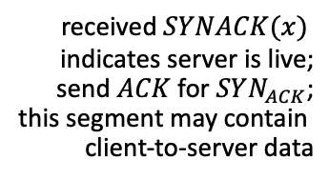
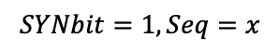
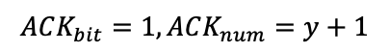
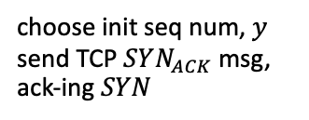
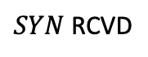
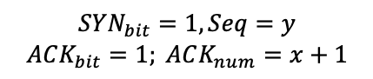
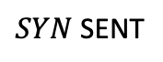
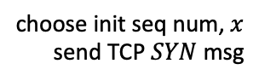
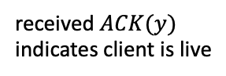
TCP 3-way handshake
client state
server state
LISTEN
LISTEN
choose init seq num, $x$
send TCP $SYN$ msg
$SYN$ SENT
$$SYNbit=1, Seq=x$$
choose init seq num, $y$
send TCP $SYN_{ACK}$msg, ack-ing $SYN$
$SYN$ RCVD
$$SYN_{bit}=1, Seq=y$$
$$ACK_{bit}=1; ACK_{num}=x+1$$
received $SYNACK(x)$
indicates server is live;
send $ACK$ for $SYN_{ACK}$;
this segment may contain
client-to-server data
ESTAB
$$ACK_{bit}=1, ACK_{num}=y+1$$
received $ACK(y)$
indicates client is live
ESTAB

Slide 23

(1) SYN flood attacks
under attack
client state
server state
LISTEN
LISTEN
choose init seq num, $x$
send TCP $SYN$ msg
$SYN$ SENT
choose init seq num, $y$
send TCP $SYN_{ACK}$msg, ack-ing $SYN$
$SYN$ RCVD
23

Slide 24
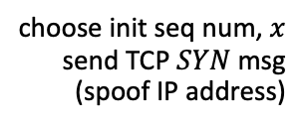
(2) SYN Flood attacks
under attack
client state
server state
LISTEN
LISTEN
choose init seq num, $x$
send TCP $SYN$ msg
(spoof IP address)
$SYN$ SENT
choose init seq num, $y$
send TCP $SYN_{ACK}$msg, ack-ing $SYN$
$SYN$ RCVD
under attack
https://www.cloudflare.com/learning/ddos/syn-flood-ddos-attack/
24

Slide 25
Complete network packet structure
ethernet frame
Ethernet header
-------------
14b
IP header
-------------
20b
TCP/UDP
header
-------------
20 bytes
payload
-------------
6 – 1460b
error check bits
-------------
4b
TCP payload
TCP segment / IP payload
IP packet / ethernet payload

Slide 26

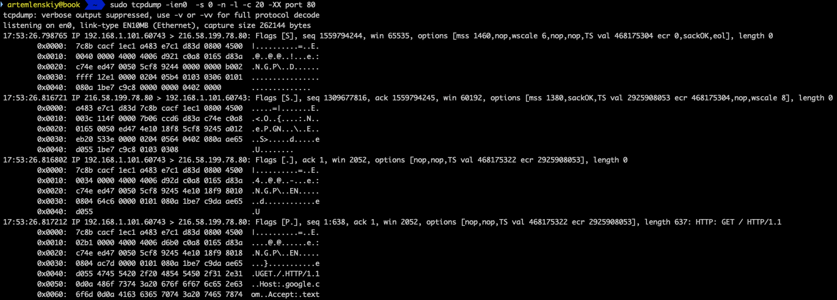
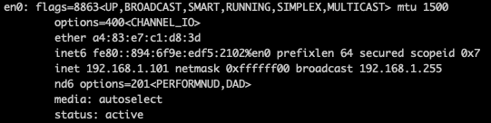
tcpdump
tcpdump command captures the live TCP/IP packets
Ethernet header
length
src mac address
IP header
TCP header
ver. & header length
src IP address
dst IP address
seq. num: 1559794244
control flags: 0x002 → 000000010 → SYN
Ptcl:TCP
TTL:64
dst
port: 80
Notes:
0050 5cf8 9244 000

Slide 27
tcpdump
Synchronize sequence numbers. Only the first packet sent from each end should have this flag set.
Push function. Asks to push the buffered data to the receiving application.

Slide 28
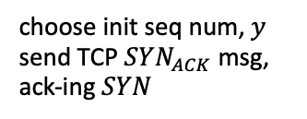
Create your own attacker
The key is to use design your own sockets (raw sockets)
Change source IP
Send a SYN TCP packet
under attack
client state
choose init seq num, $x$
send TCP $SYN$ msg
(spoof IP address)
choose init seq num, $y$
send TCP $SYN_{ACK}$msg, ack-ing $SYN$
under attack

Slide 29
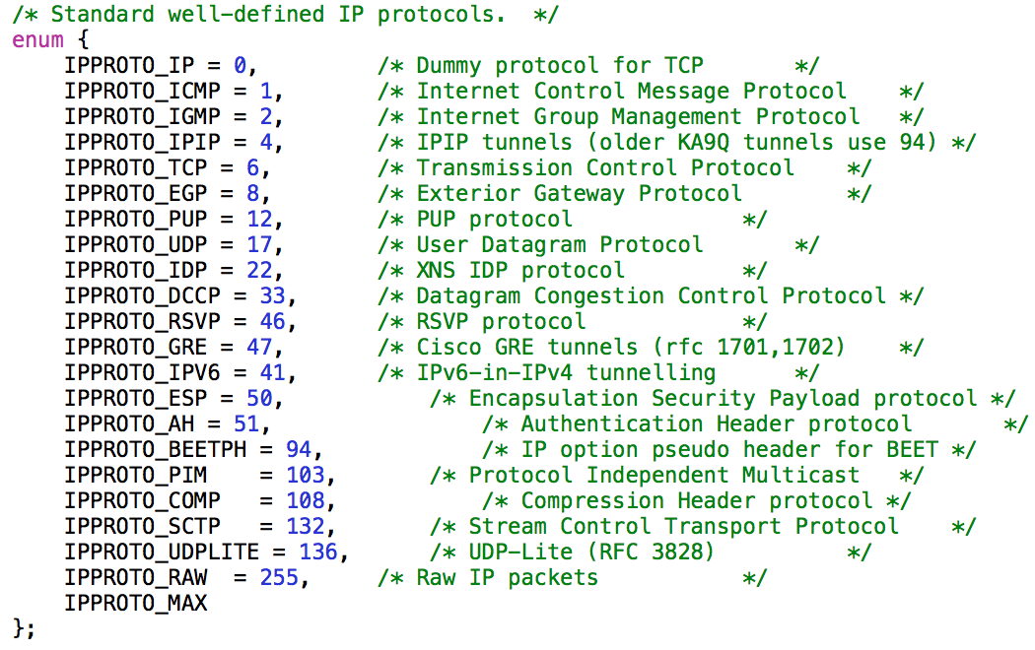
Creating raw sockets
int s = socket (PF_INET, SOCK_RAW, *int protocol*);
The 3rd argument: IPPROTO_XXX defines the actual protocol above IP.

Slide 30
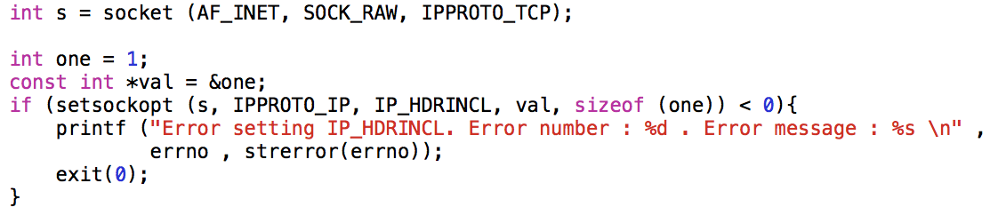
Creating raw sockets
We must provide the TCP header along with the data. The kernel or the network stack of Linux shall provide the IP header.
If we want to provide the IP header as well then there are 2 ways of doing this
Use protocol IPPROTO_RAW - This will allow to specify the IP header and everything that is contained in the packet.
Set the IP_HDRINCL socket option to 1.
When using the IP_HDRINCL the protocol used in the socket function is effectively of no use.

Slide 31
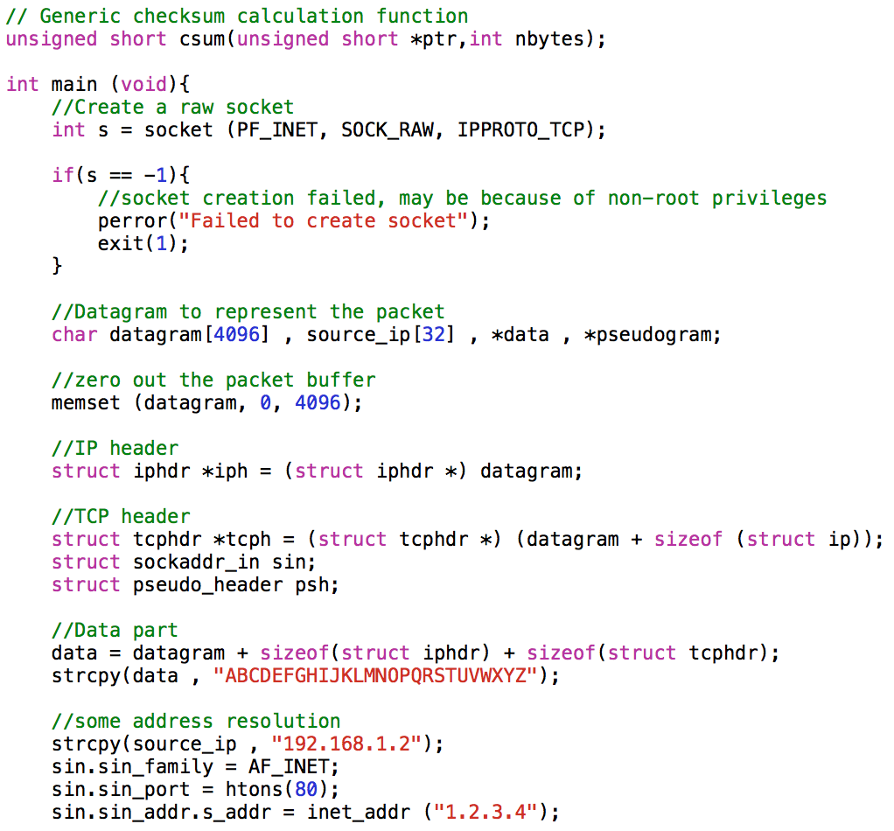
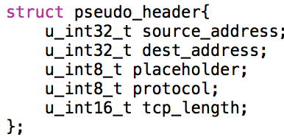
Creating raw sockets
96 bit (12 bytes) pseudo header needed for TCP header checksum calculation

Slide 32
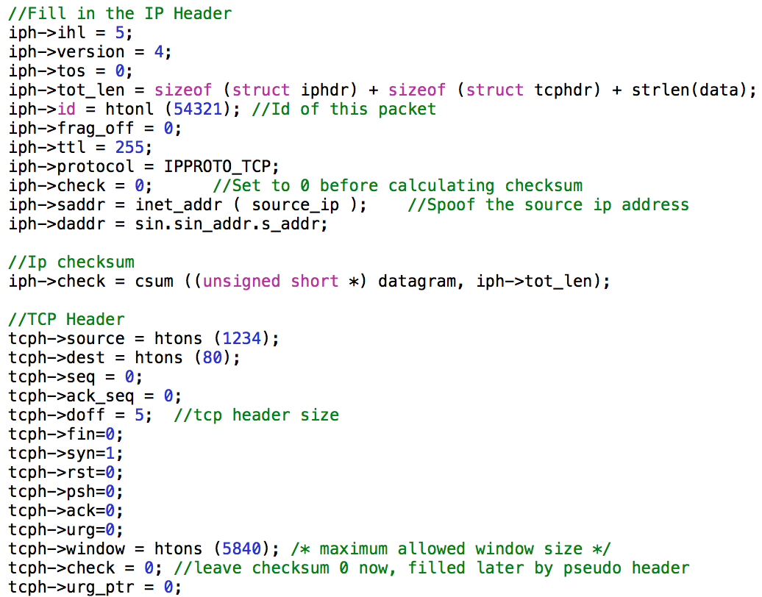
Creating raw sockets
Fill in IP and TCP headers

Slide 33
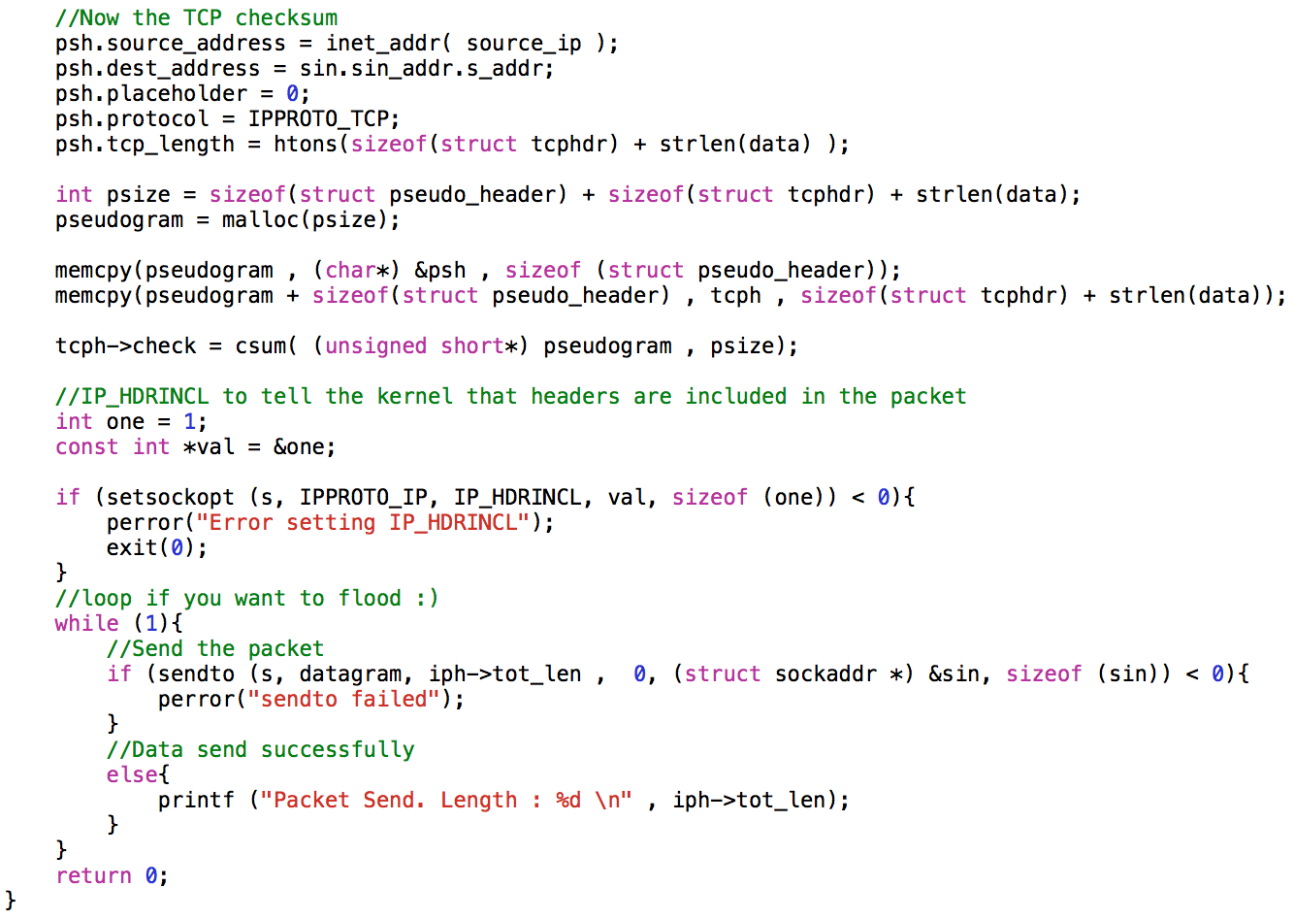
Creating raw sockets

Slide 34
Questions
Feel free to contact me by artem.lenskiy@anu.edu.au

Slide 35
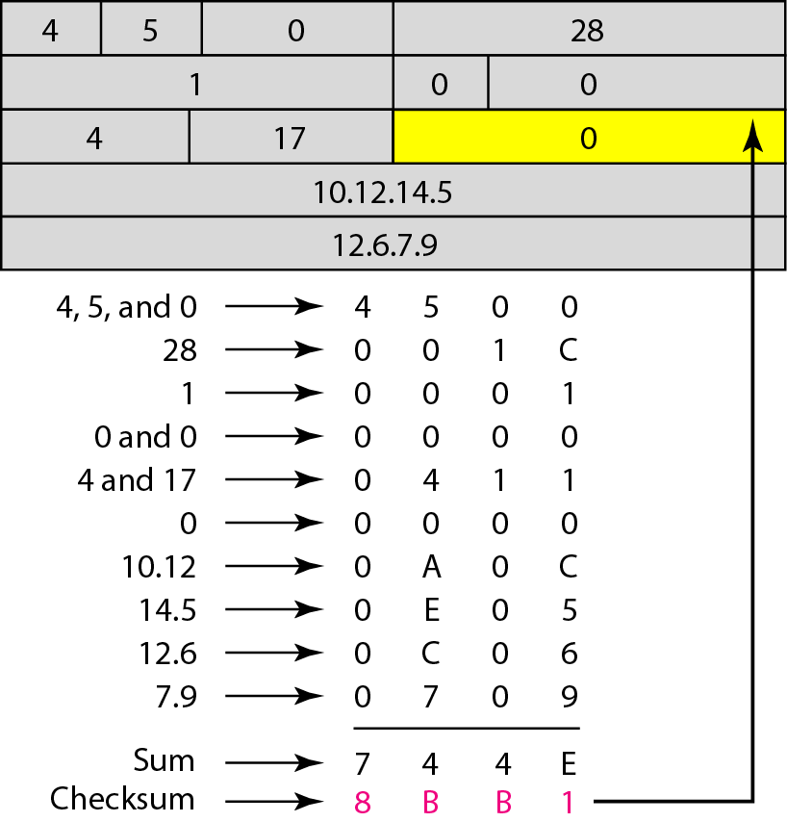
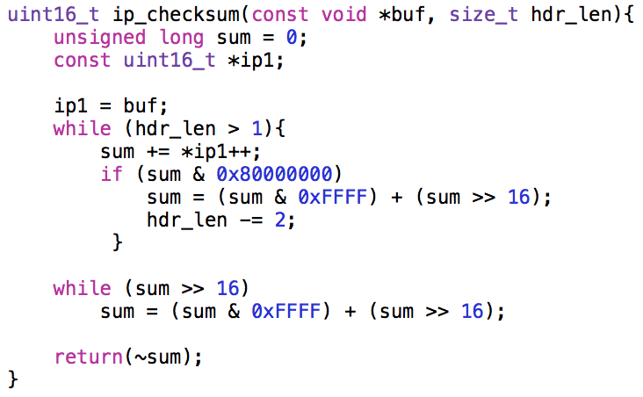
Appendix A: IP packet header checksum

